Slide 1
ASL-2-txt
Kevin Dibble, Jasmine Moran, Susan Souza

Slide 2
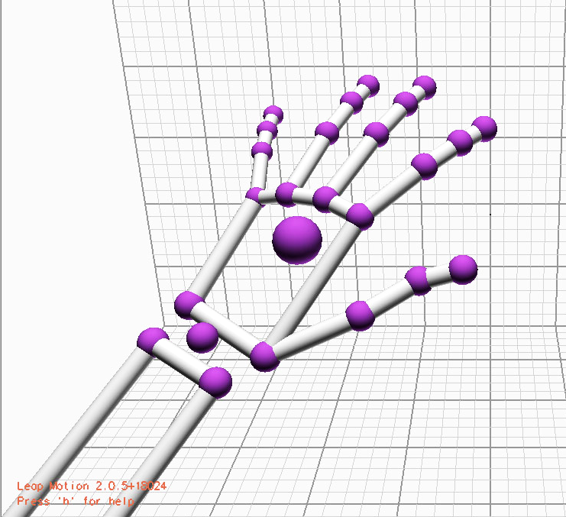
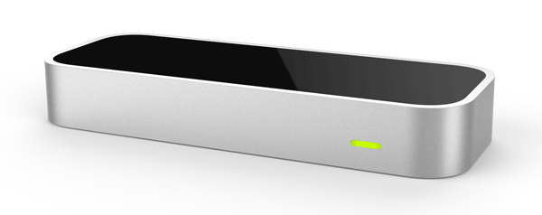
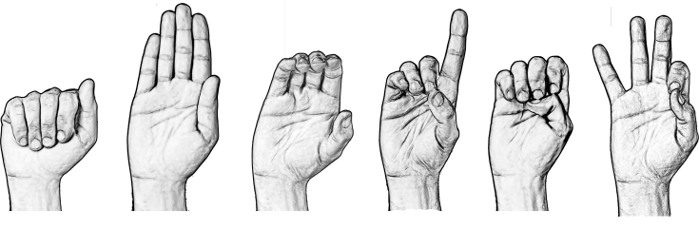
Core Features
https://www.pixeljumble.com/images/reviews/leaphandfullsize.jpg
http://www.lifeprint.com/asl101/images-layout/abcdrawings.gif
http://www.techforanyone.com/wp-content/uploads/2013/12/leap-motion-controller.png

Slide 3
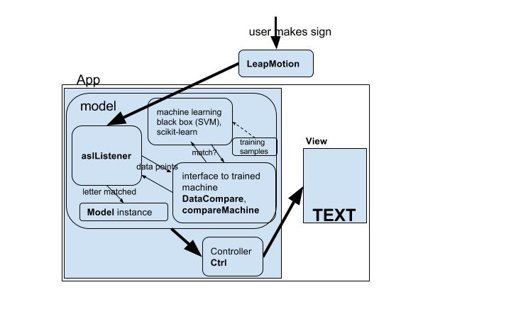

Slide 4

Design Approach and Progression
http://johnnyholland.org/wp-content/uploads/building-blocks1.jpg

Slide 5

Design Approach and Progression (cont’d)
http://techyinfinte.com/wp-content/uploads/2016/03/gears.jpg

Slide 6
Video Demonstration
https://drive.google.com/file/d/0B0DhBKfxZvDISU1EU3RKd2lxMWc/view?usp=drivesdk

Slide 7

Result and Reflection
http://acmaps.info.yorku.ca/files/2013/06/LookingGood.png
Notes:
Current system detects letters, adds spaces on absence of hand, and clears the output when no hands are detected for a long time
The LeapMotion really wasn’t the right tool for the job. Lack of precision and hand positions that blocked vision
Potential solutions to the lack of accuracy, which we could not explore given time limitations, include things like adding the actual image data the LeapMotion captures to our datasets, as well as position data in addition to our directional data for fingers, hand(palm) and wrist

Slide 8
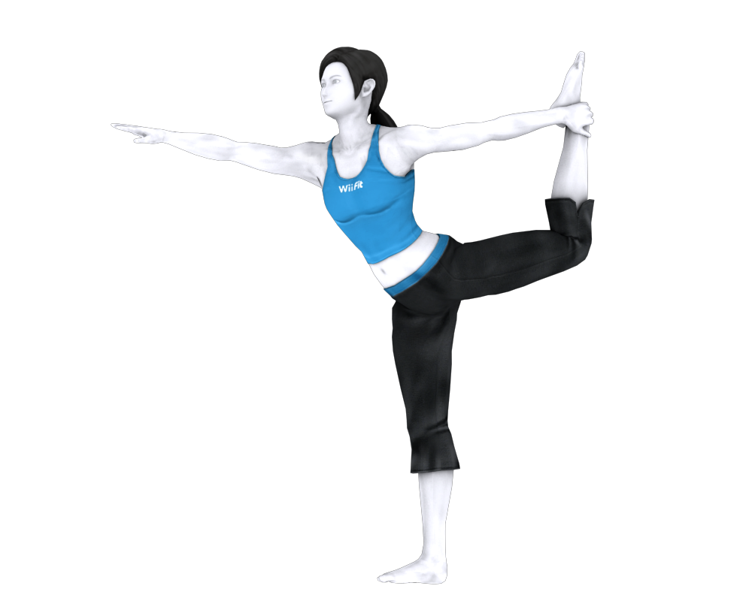
Unfinished Stretch Goals
http://orig15.deviantart.net/b404/f/2015/204/a/6/wii_fit_trainer_dl_by_jerichoakemi-d92jnhz.png
Notes:
Due to problems with precision of the LeapMotion, we were not able to complete our stretch goals.
Started work on punctuation (we have spaces)
Have the infrastructure for single-hand words
Were unable to develop a tutorial for using the software

